Slide 1

Fakultas Ilmu Komputer
Learning is the process of acquiring new understanding, knowledge, behaviors, skills, values, attitudes, and preferences.
Framework #7-1
[Create Database & Tables]

Slide 2

Welcome to the Framework Programming course

Slide 3
Three Important MVC Components (layers)
Component #1  Model :
The model component stores data and its related logic. It represents data that is being transferred between controller components or any other related business logic. For example, a Controller object will retrieve the customer info from the database. It manipulates data and send back to the database or use it to render the same data.
It responds to the request from the views and also responds to instructions from the controller to update itself. It is also the lowest level of the pattern which is responsible for maintaining data.
Component #2  View :
The View is that part of the application that represents the presentation of data.
Views are created by the data collected from the model data. A view requests the model to give information so that it resents the output presentation to the user.
The view also represents the data from chats, diagrams, and table. For example, any customer view will include all the UI components like text boxes, drop downs, etc.
Component #3  Controller :
The Controller is that part of the application that handles the user interaction. The controller interprets the mouse and keyboard inputs from the user, informing model and the view to change as appropriate.
A Controller send's commands to the model to update its state (E.g., Saving a specific document). The controller also sends commands to its associated view to change the view's presentation (For example scrolling a particular document).
The paper was published under the title:
Burbeck, Steve. "Applications programming in smalltalk-80 (tm): How to use model-view-controller (mvc)." Smalltalk-80 v2 5 (1992): 1-11.

Slide 4



Three Important MVC Components (layers)
Model: It includes all the data and its related logic.
View: Present data to the user or handles user interaction.
Controller: An interface between Model and View components.

Slide 5
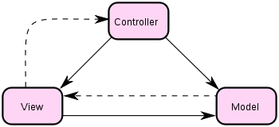
Three Important MVC Components (layers)
logic program (controller)
Tampilan (view) => UI
Manage the data

Slide 6

phpMyAdmin in XAMPP
Bringing MySQL to the web
phpMyAdmin is a free software tool written in PHP, intended to handle the administration of MySQL over the Web. phpMyAdmin supports a wide range of operations on MySQL and MariaDB. Frequently used operations (managing databases, tables, columns, relations, indexes, users, permissions, etc) can be performed via the user interface, while you still have the ability to directly execute any SQL statement.
Read Source:
https://www.phpmyadmin.net/

Slide 7
MySQL
MySQL is a relational database management system based on SQL – Structured Query Language. The application is used for a wide range of purposes, including data warehousing, e-commerce, and logging applications. The most common use for mySQL however, is for the purpose of a web database. It can be used to store anything from a single record of information to an entire inventory of available products for an online store. In association with a scripting language such as PHP or Perl, it is possible to create websites which will interact in real-time with a mySQL database to rapidly display categorised and searchable information to a website user.
Read Source:
https://www.123-reg.co.uk/support/servers/what-is-mysql-and-why-do-i-need-it/

Slide 8

1 – Create Database in XAMPP using phpMyAdmin

Slide 9
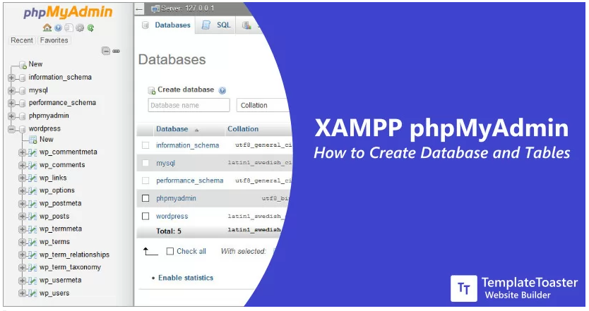

Recommended to install XAMPP before we start to this lecture. We might need to test our AIMVC project can run locally. If you find any problems related to installing and configuring XAMPP phpMyAdmin, then please find previous lecture in this class or any tutorials to solve it.

Slide 10
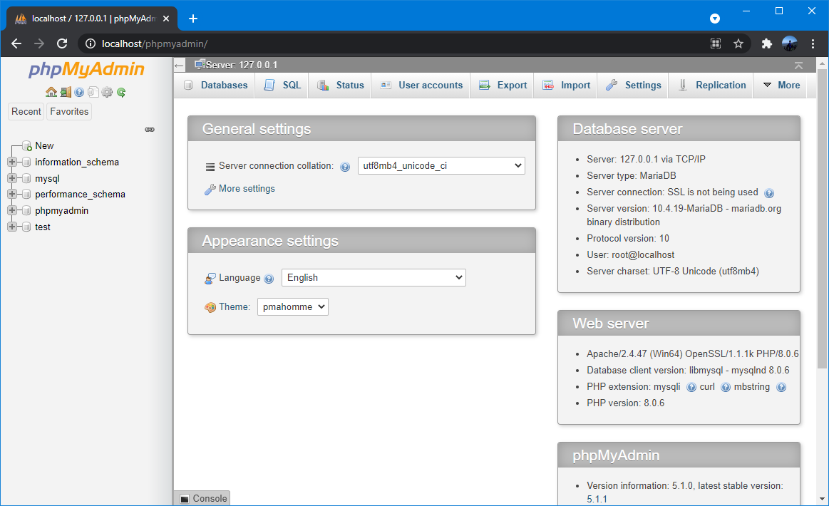
Navigate to Database on phpMyAdmin
Navigate cursor to http://localhost/phpmyadmin/ and click button “new”.

Slide 11
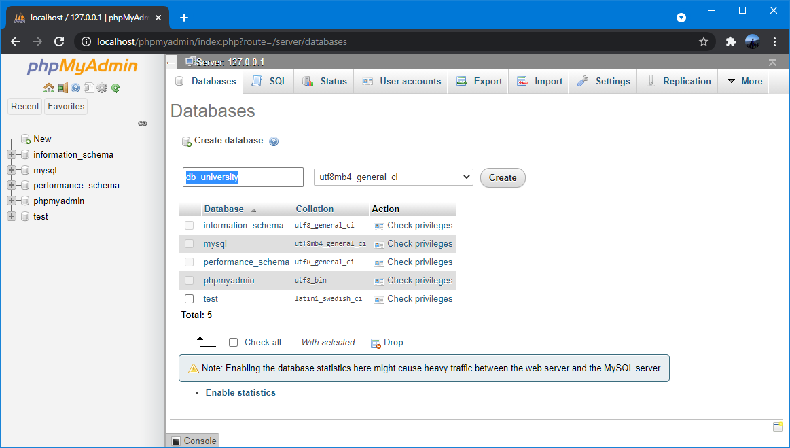
Create a Database
See the option to “Create a Database” and input field to enter the database name. Write the database name and click the “Create” button.

Slide 12
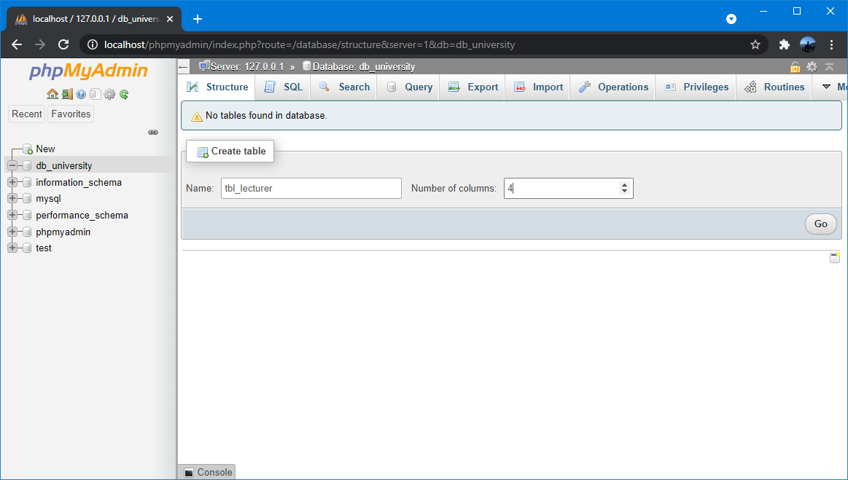
Create Tables Using phpMyAdmin
By default the HostName is ‘localhost’, MySQL user is ‘root’ and have no password.
In the phpMyAdmin click on the “Structure” tab and click on the “Create new table on database” wizard to get started. You can see above fields, you can add the table name and the total number of fields (columns) and click the “‘Go” button.

Slide 13
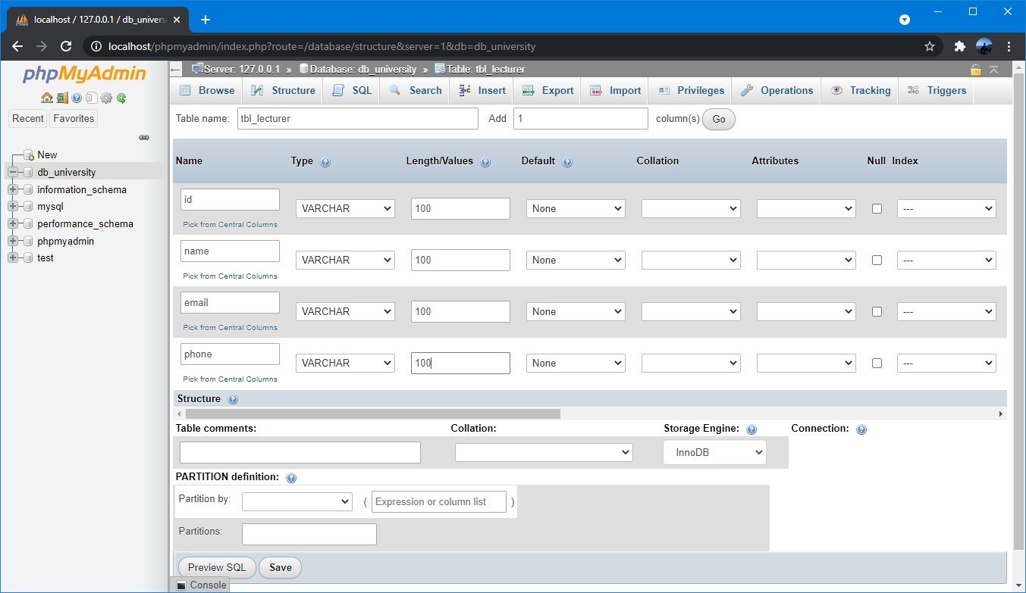
Specify Data Type
After the data type, you can specify other optional attributes for each column.

Slide 14
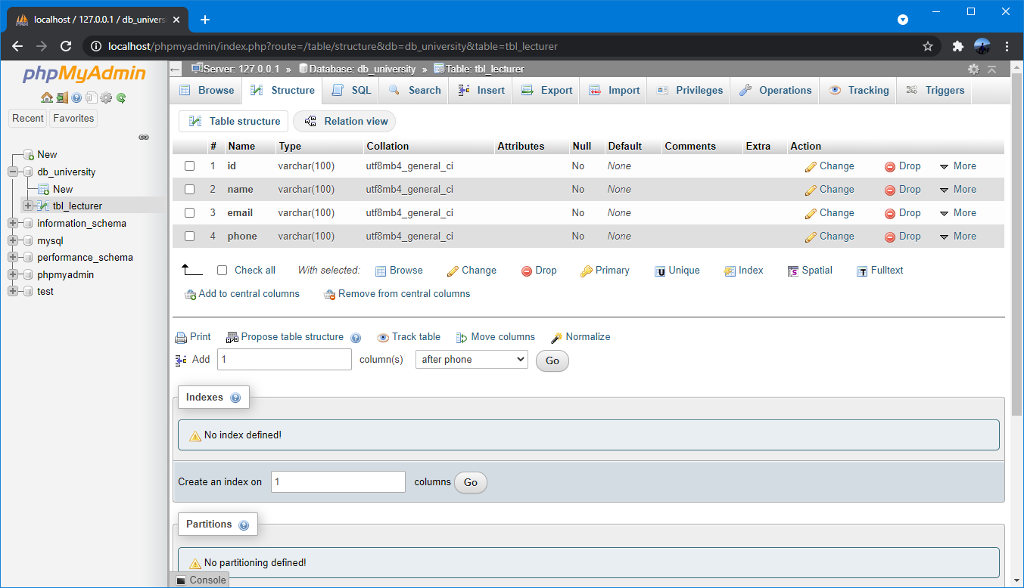
Table Structure

Slide 15
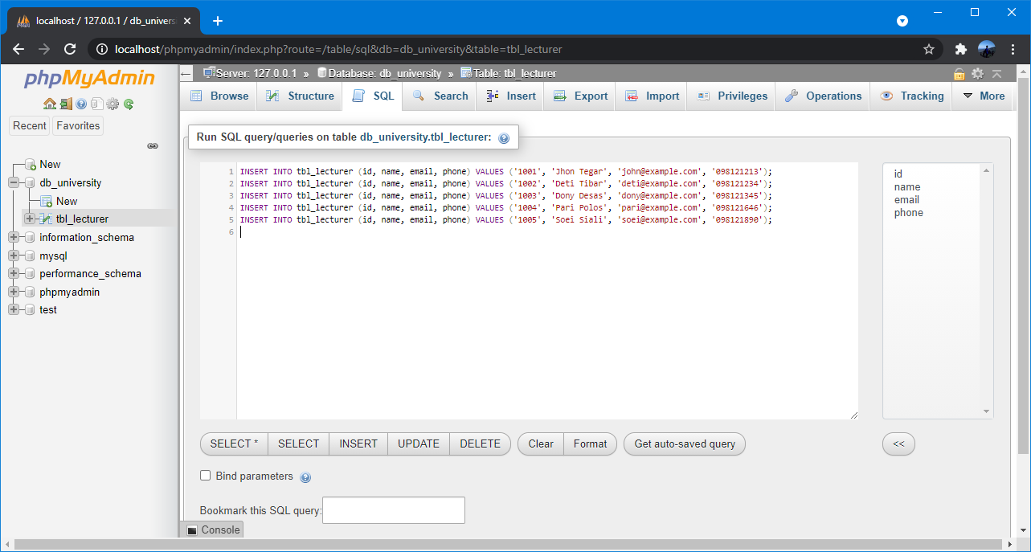
MySQL Insert Data via SQL Suery
INSERT INTO tbl_lecturer (id, name, email, phone) VALUES ('1001', 'Jhon Tegar', 'john@example.com', '098121213');
INSERT INTO tbl_lecturer (id, name, email, phone) VALUES ('1002', 'Deti Tibar', 'deti@example.com', '098121234');
INSERT INTO tbl_lecturer (id, name, email, phone) VALUES ('1003', 'Dony Desas', 'dony@example.com', '098121345');
INSERT INTO tbl_lecturer (id, name, email, phone) VALUES ('1004', 'Pari Polos', 'pari@example.com', '098121646');
INSERT INTO tbl_lecturer (id, name, email, phone) VALUES ('1005', 'Soei Siali', 'soei@example.com', '098121890');

Slide 16
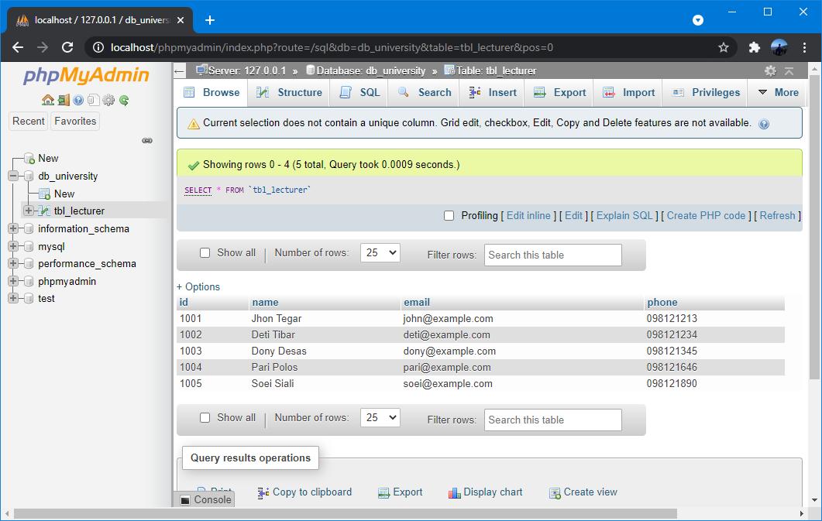
Data from a MySQL Database

Slide 17
2 – Set Password to phpMyAdmin on XAMPP

Slide 18
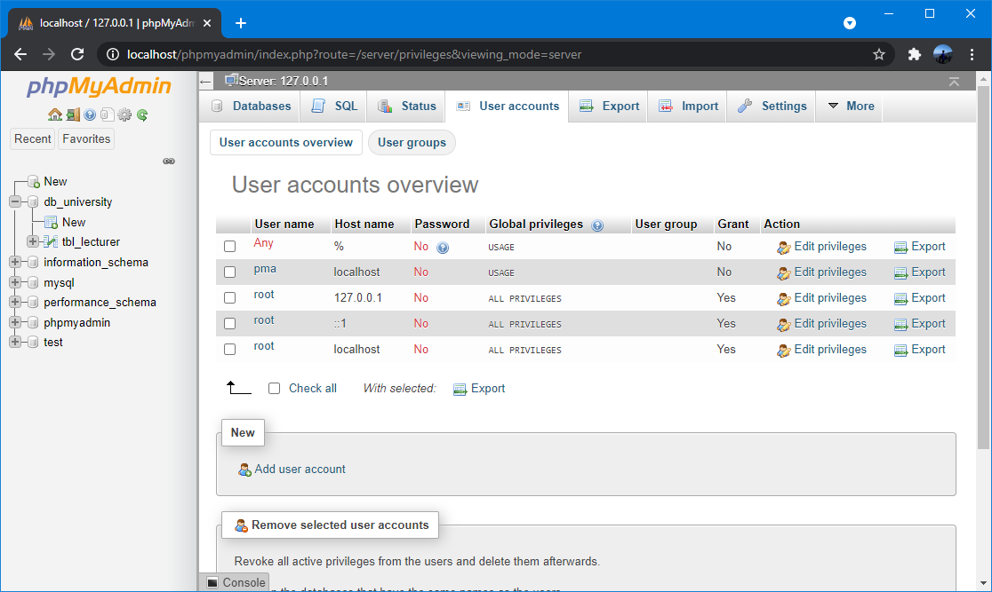
User Accounts
Click on the “user accounts” option at the top of the page and press the “edit privileges” under “actions” option for the Username “root” and Hostname “localhost”.

Slide 19
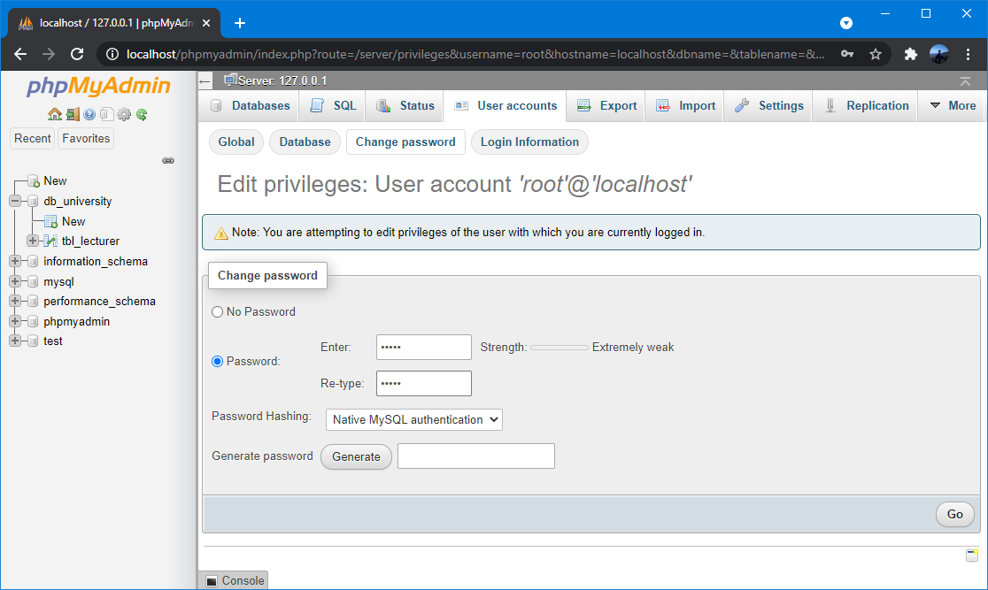
Change/Edit Password
Choose the third tab “change password” and type your password in the provided field, retype the password to confirm it and then finally click on the “Go” button to conclude the process.

Slide 20
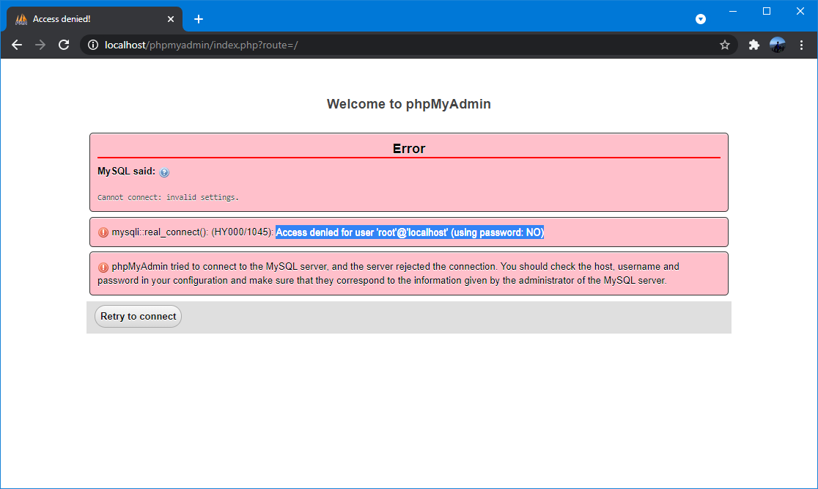
Error Access Denied

Slide 21
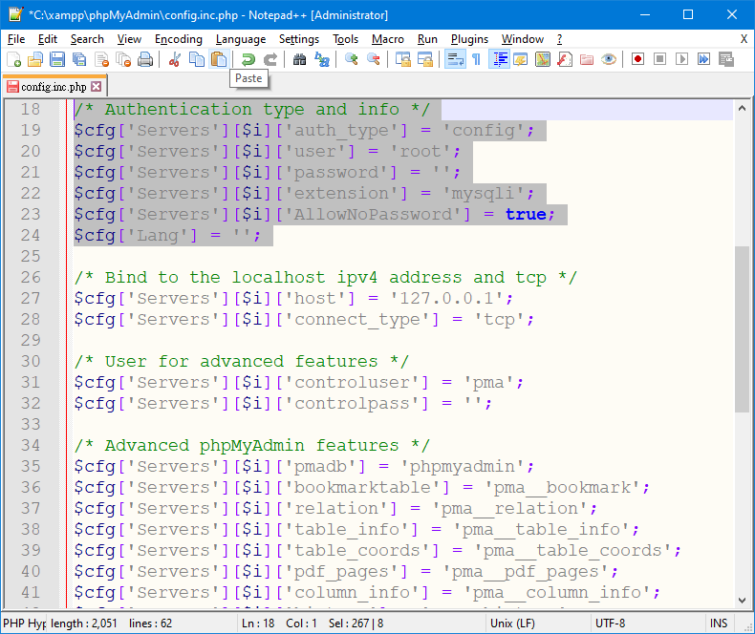
Configuration Settings [allow without password]
ERROR #1045 - Access denied for user 'root'@'localhost' (using password: NO) when opening http://localhost/phpmyadmin.
Navigate to "C:\xampp\phpMyAdmin"
Find the file "config.inc.php" and open in a Notepad or better, Notepad++ (run as adminstrator).
At line # 18 to 24, is the settings for user authentication.
Change the values to :
/* Authentication type and info */
$cfg['Servers'][$i]['auth_type'] = 'cookie';
$cfg['Servers'][$i]['user'] = 'root';
$cfg['Servers'][$i]['password'] = 12345 ';
$cfg['Servers'][$i]['extension'] = 'mysqli';
$cfg['Servers'][$i]['AllowNoPassword'] = false;
$cfg['Lang'] = '';
password: password is not set in the configuration file.

Slide 22
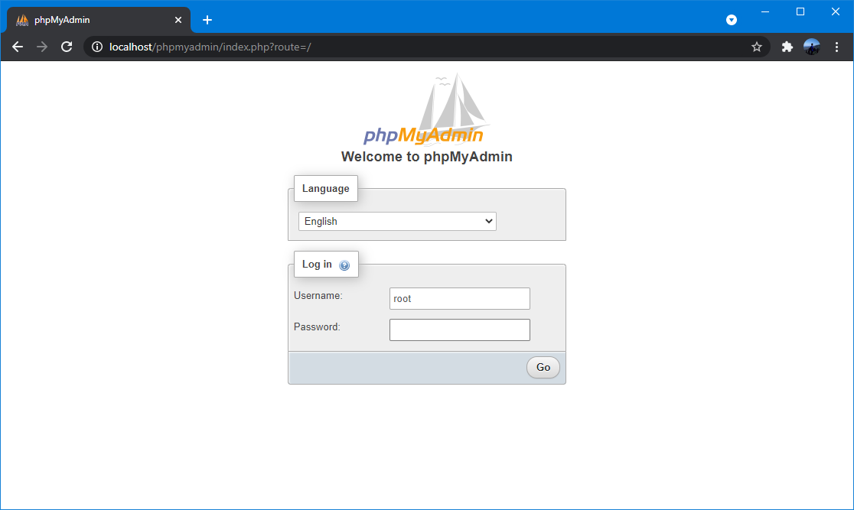
Testing

Slide 23

THANK YOU
END PRESENTATION
Thank you for your attention
Instructor: S – W – T

